Slide 1
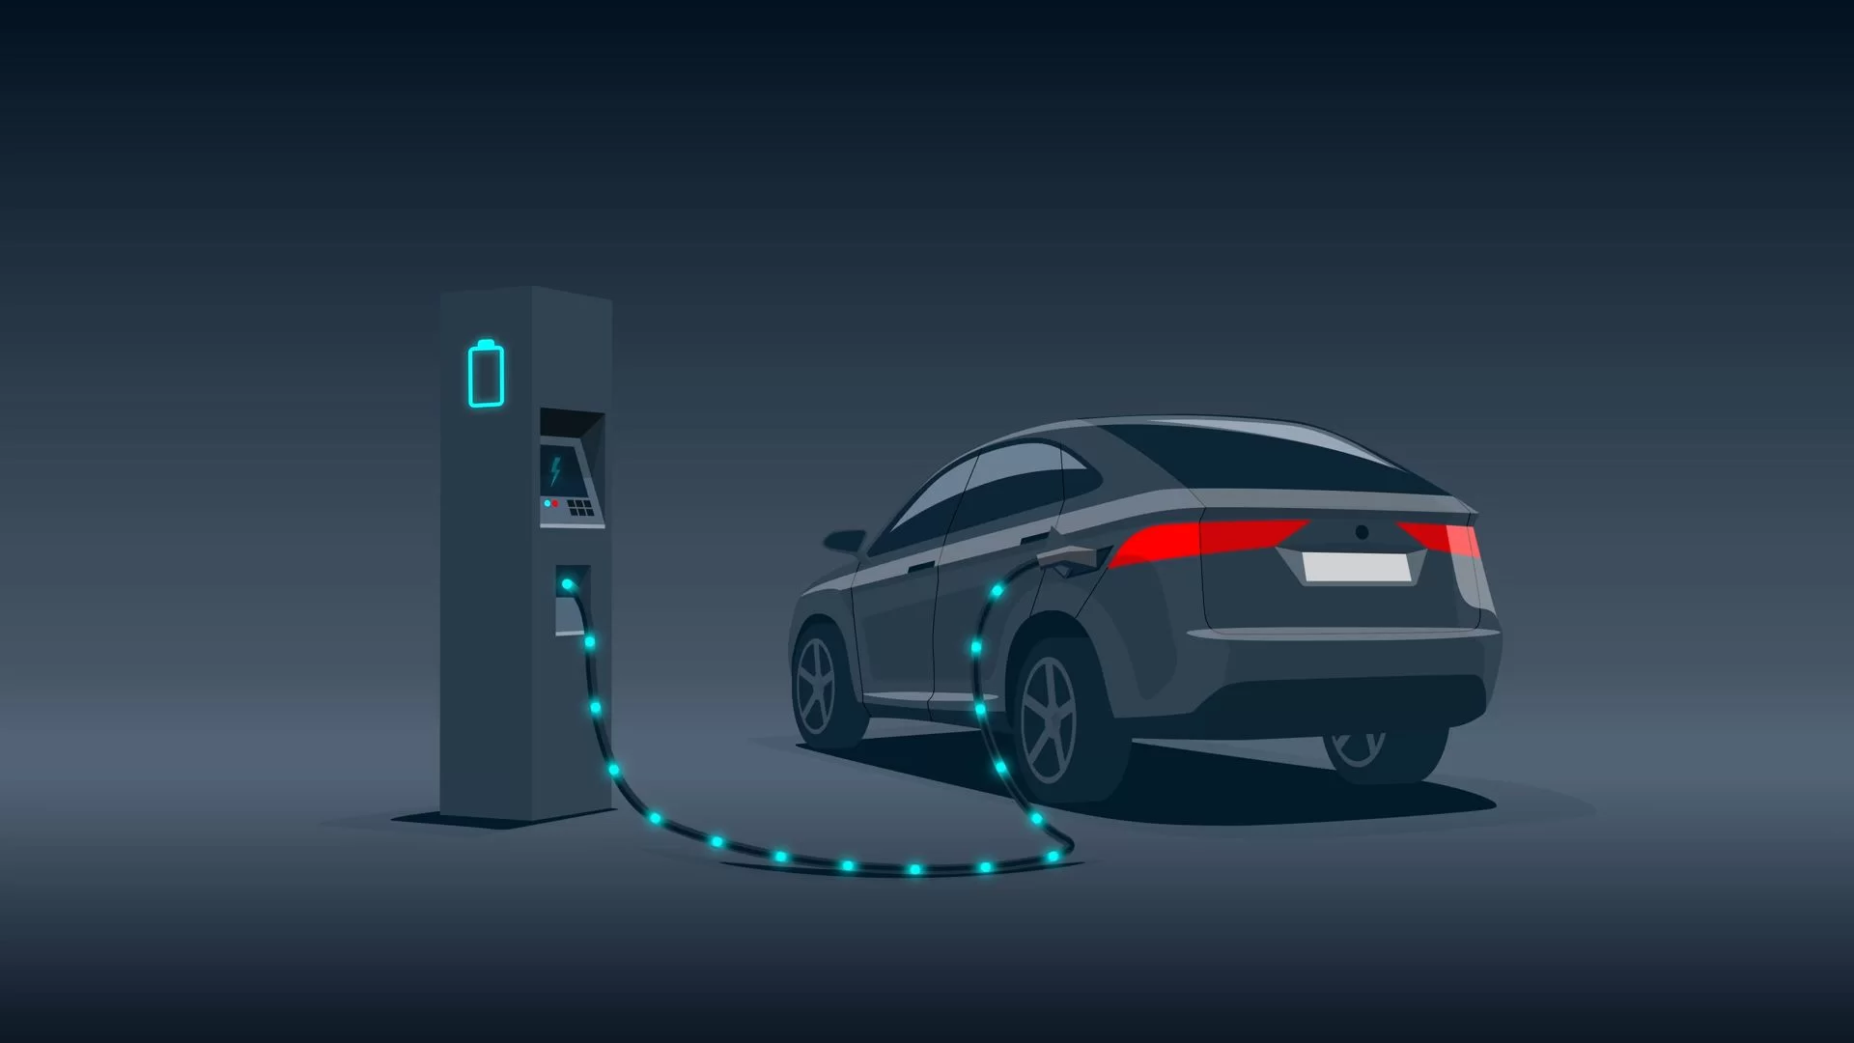


Category: Open Innovation
Problem Statement: Despite rising popularity, electric vehicles struggle to break free from their "second car" identity. Limited range and unreliable long-distance charging infrastructure force consumers to rely on gas-guzzlers for extended trips, perpetuating dependence on fossil fuels and hindering EV adoption. ​
Can we overcome these limitations and unlock EVs' full potential as viable primary vehicles, accelerating the shift towards a cleaner transportation future?​
Team Name: StrawHats (Team No. 4)

Slide 2

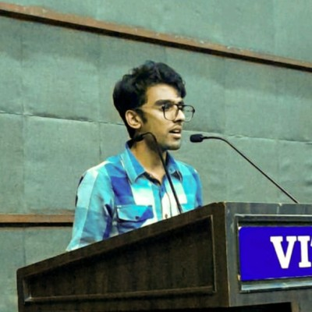


The TEAM
Neeraj Balamurali
BTech. I.T student from RSET with a passion for aerospace engineering and aspires to work for ISRO someday.
Pranav Krishnan
BTech. Mechanical Engineering student from VIT Chennai with a deep interest in production technologies.
Rohit C Ajith
BTech. CSE student from VIT Vellore. A cybersecurity enthusiast and a national combat roboteer.
Adwyth Sumesh
BTech. CSE student from VIT Chennai. Driven by a passion for AI/ML, he's actively involved in numerous projects.

Slide 3
Our Hypothesis
Through our problem statement, we aim to develop a reliable and fast growing charging network in India allowing citizens to rent out their land as a charging station and install level 2 charging stations, giving them a source of passive income and increasing our network for EV users throughout the country reducing range anxiety.
Our service showcase a variety of values:
Functional Value :
Providing More Charging Spots: This directly addresses the functional need for electric vehicle (EV) users in India to have convenient and accessible charging infrastructure. By increasing the number of charging spots, it enhances the practicality and usability of EVs, making them a more viable option for daily transportation.
Recipient: EV owners
Emotional Value:
A Stress free Mind: The availability of an extensive network of charging spots alleviates one of
the primary concerns for EV owners—range anxiety. Knowing that there are ample charging stations
accessible allows EV owners to confidently plan their journeys without worrying about running out of
battery power.
Recipient: EV owners

Slide 4
Brand Value:
Innovation and Sustainability: By addressing the charging infrastructure limitations, the initiative reflects a commitment to innovation and sustainability. This can positively impact the brand image, positioning the company or entities involved as forward-thinking, environmentally conscious, and customer-focused.
Recipient: Those who are involved in bringing this to the markets.
Economic Value:
Win for Entrepreneurs and Investors: The development of a robust charging network presents business opportunities for entrepreneurs and investors in the clean energy and technology sectors. This economic value attracts private investments, fostering innovation and growth in related industries.
Win for the Homeowners (or so we call the charging hosts): Homeowners who offer their premises as charging stations can earn a passive source of income. This additional revenue stream can help them offset energy costs or contribute to other household expenses, providing financial relief.
Recipients: Entrepreneurs, Investors, Charging Hosts and last of all, we who implemented the system.

Slide 5
Where does our Solution Component Fit?
ML Based Training Models for location planning
Domain: Intelligent Systems
Role: ML plays a prominent role here. When the user inputs the charge of the current battery power in the app, the app suggests a list of best locations to charge the vehicle on the go after considering the traffic density as well.
IoT-enabled Charging Infrastructure:
Domain: Internet of Things (IoT)
Role: Implementing cameras for real-time monitoring of charging stations, ensuring security of the vehicles as well as the safety of the owner’s place.
User-Friendly Mobile Application (CX/UI):
Domain: Customer Experience/User Interface
Role: Providing an intuitive and user-friendly mobile app for EV owners to locate and navigate to nearby charging stations, check availability, and book the spots.

Slide 6
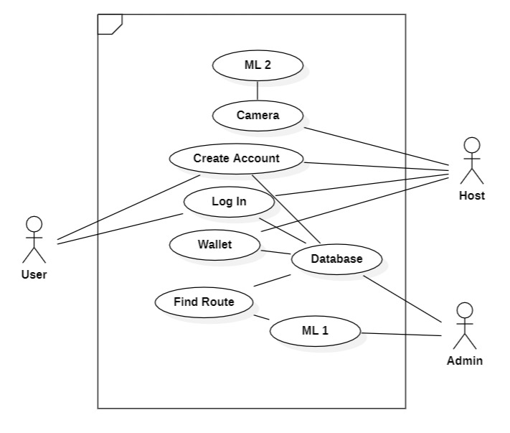
A Use Case Diagram of our concept

Slide 7
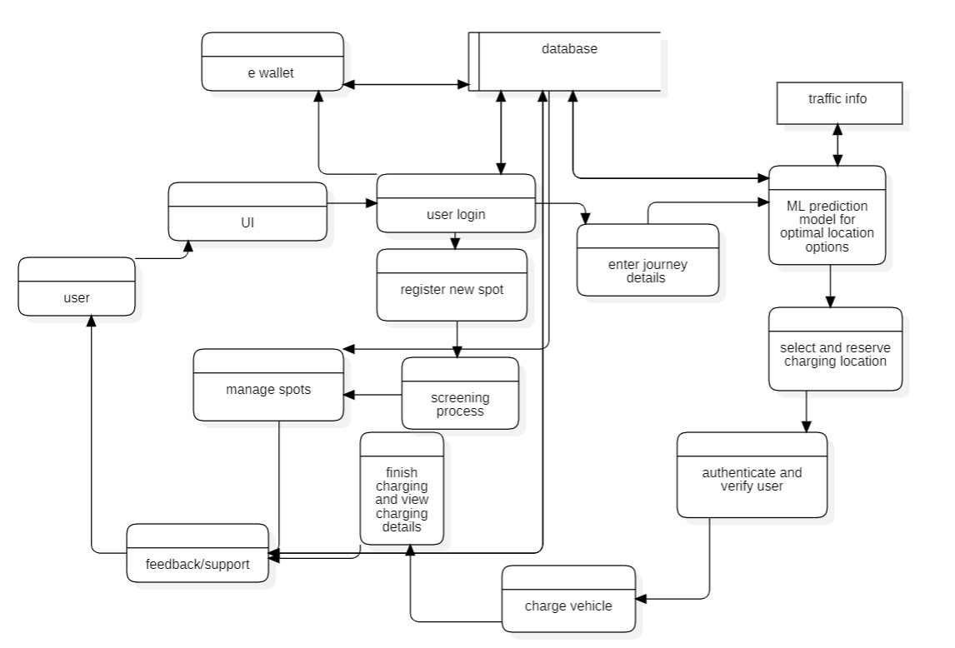
A data flow diagram of our concept

Slide 8
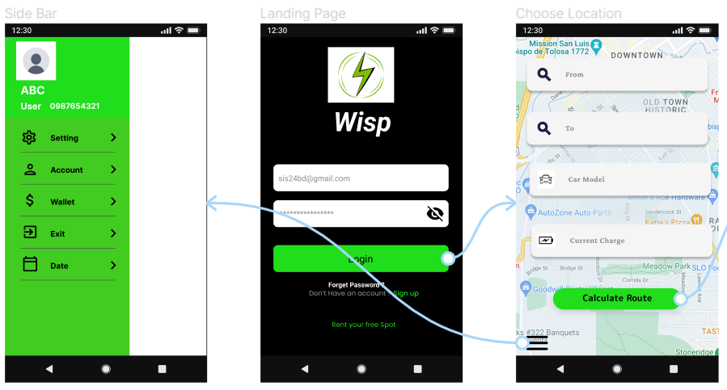
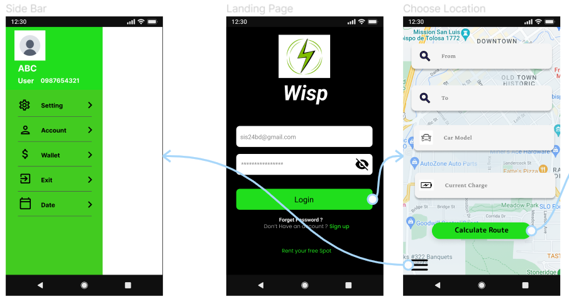
Prototype (User View)

Slide 9
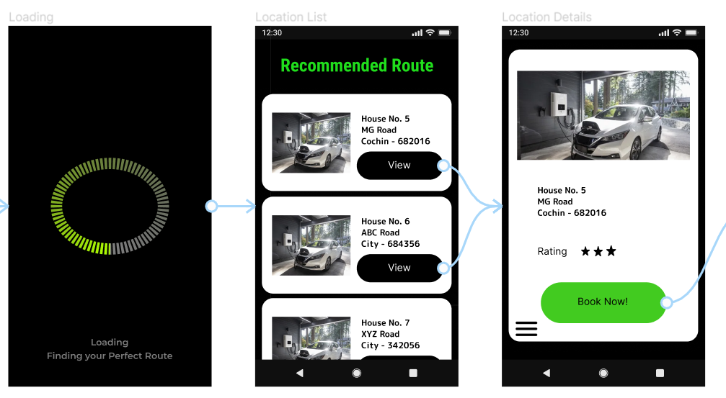
Prototype (User View)

Slide 10
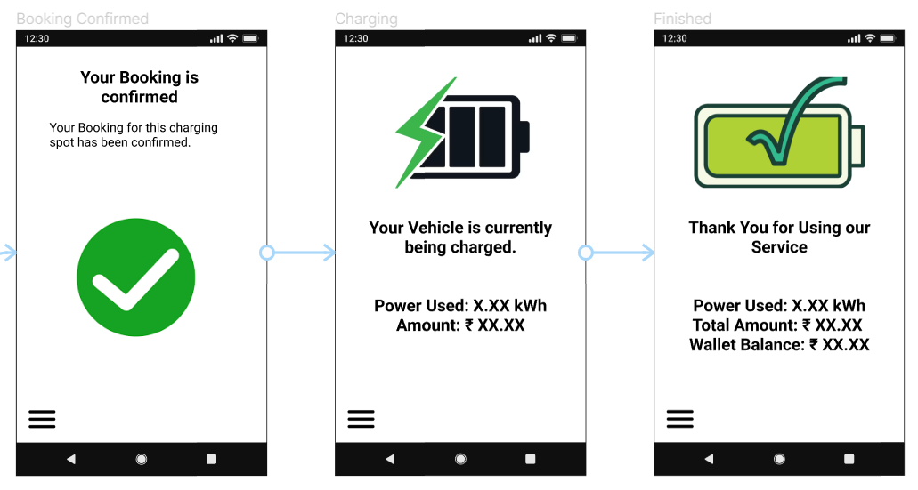
Prototype (User View)

Slide 11
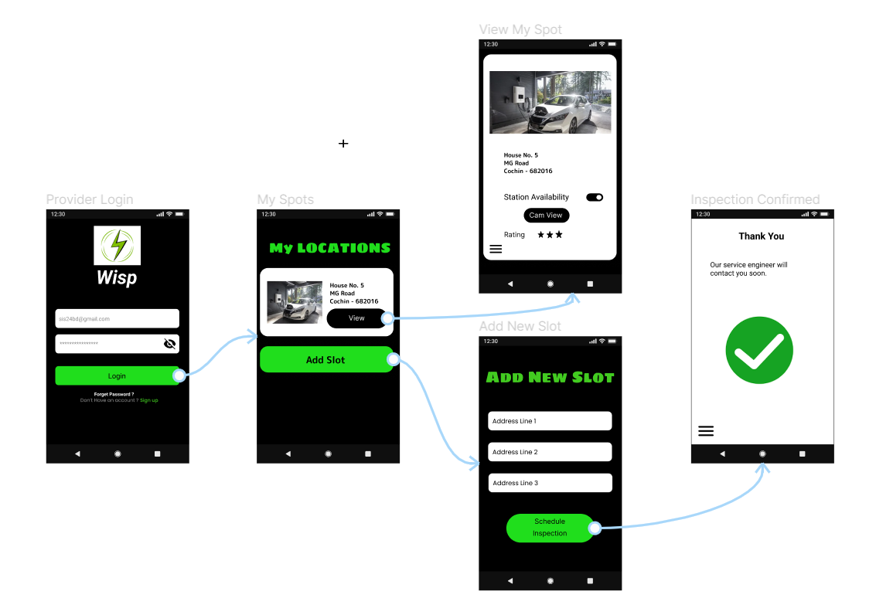
Prototype (Host View)

Slide 12

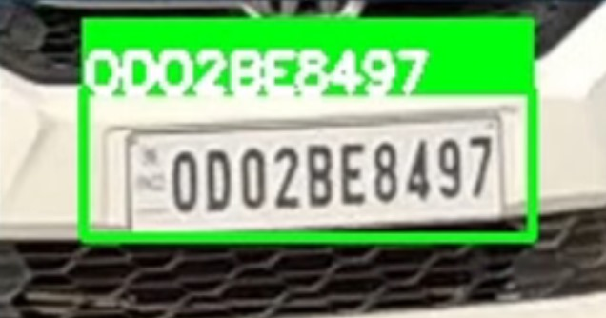
Using a camera placed in front of the EV charger and a trained YOLO model, a licence plate recognition model is made to be able to authenticate and verify when users enter the charging spot and leave, ensuring accurate rates for the services. EV hosts are also alerted if suspicious activity is viewed through the camera in-app.

Slide 13
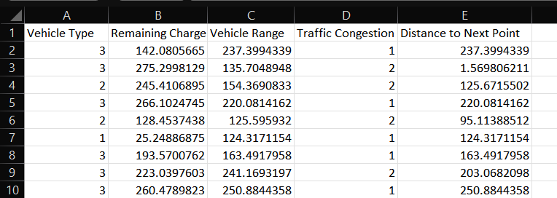
We trained 3 different ML models using a dataset to test and see which model has the most accurate prediction when compared to our use case.
The dataset

Slide 14
These are the results found from each of the models:
Linear Regression
test_MSE: 2067.912515559059
test_MAE: 31.864246914606802
R2_score:0.6818153867268602
Random Forest
test_MSE: 1892.8635504445713
test_MAE: 26.55749572511886
R2_score:0.7087497405013761
XGBoost Model
test_MSE: 2064.8715128525505
test_MAE: 27.444053969450852
R2_score:0.6822832983347511

Slide 15
Based on the Mean Squared Error (MSE), Mean Absolute Error (MAE), and R2 Score for the Linear Regression, Random Forest, and XGBoost models, the Random Forest model seems to perform the best.
The Random Forest model has the lowest MSE (1892.8635504445713) and MAE (26.55749572511886), and the highest R2 Score (0.7087497405013761).
These metrics indicate that the Random Forest model has the smallest average squared difference between the actual and predicted values (MSE), the smallest average absolute difference between the actual and predicted values (MAE), and the highest proportion of variance in the dependent variable that is predictable from the independent variables (R2 Score).

Slide 16
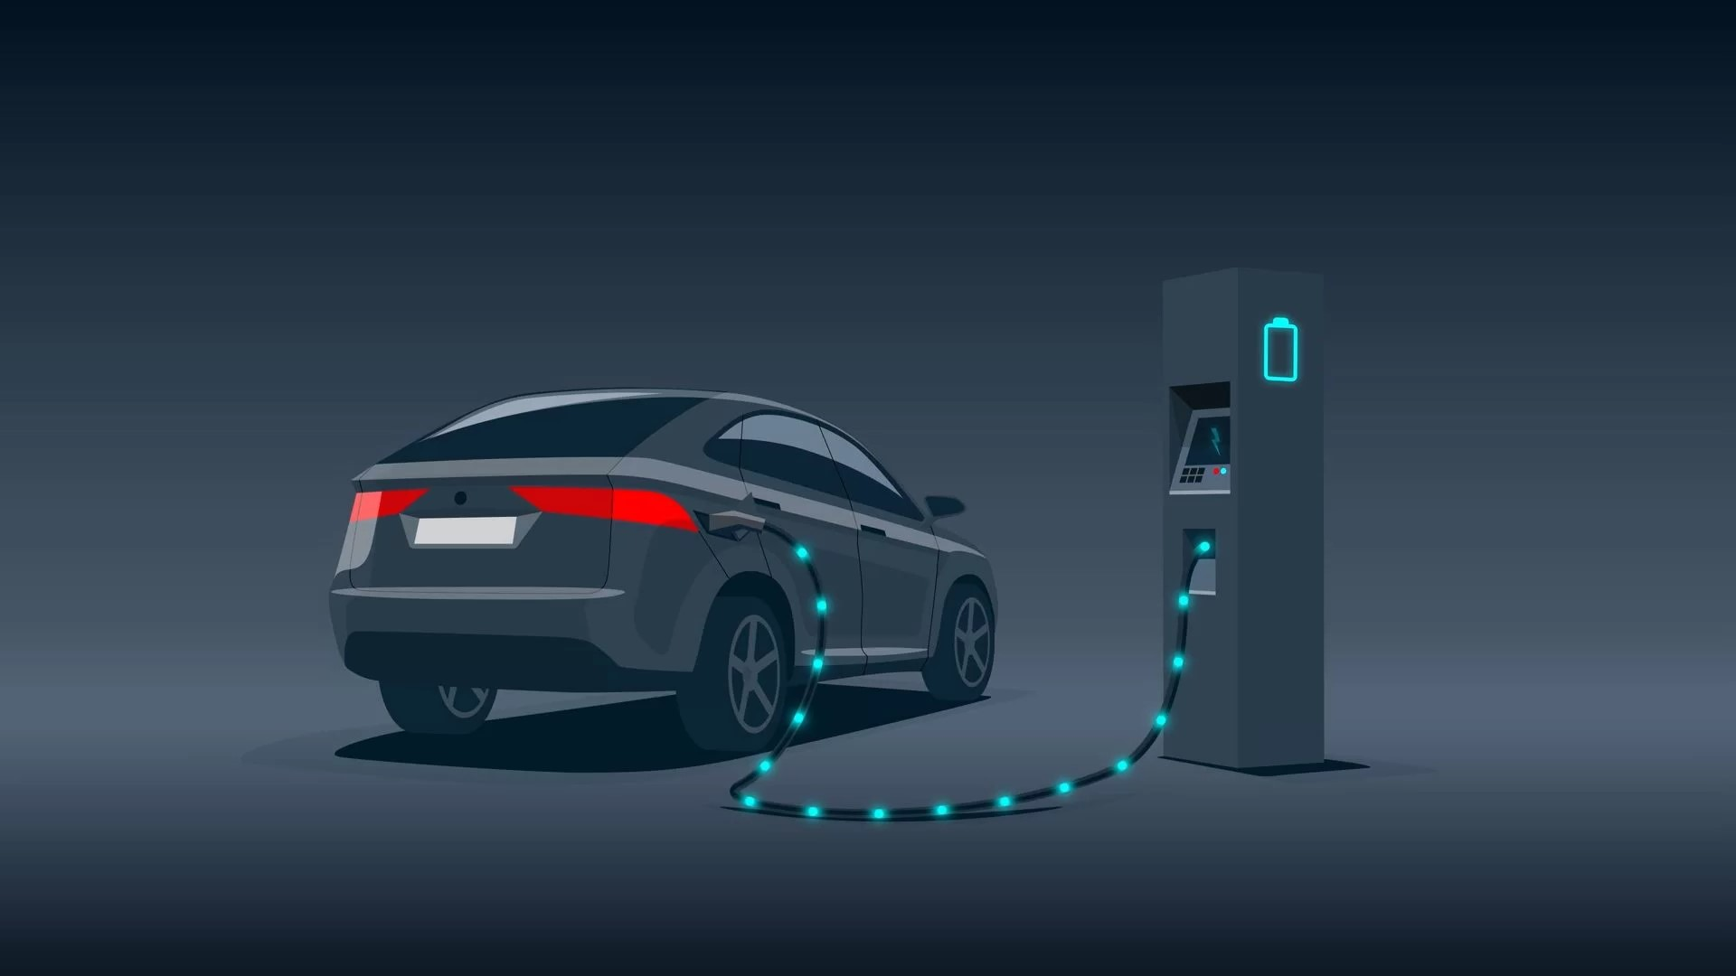
Thank You

